Slide 1
TRANSPORT LAYER
INTRODUCTION
TRANSPORT LAYER PROTOCOLS
UDP
TCP

Slide 2
INTRODUCTION
The transport layer is located between the application layer and the network layer.
It provides a process-to-process communication between two application layers, one at the local host and the other at the remote host

Slide 3
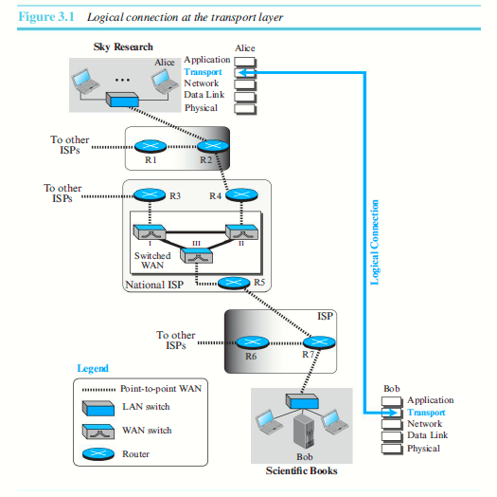

Slide 4
TRANSPORT LAYER SERVICES
Process-to-Process Communication:
A process is an application-layer entity (running program) that uses the services of the transport layer.
Network Layer – Host to Host - A network-layer protocol can deliver the message only to the destination computer.
Transport Layer: A transport-layer protocol is responsible for delivery of the message to the appropriate process

Slide 5
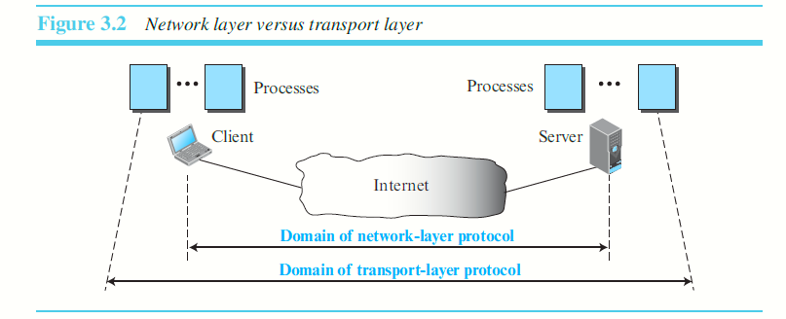

Slide 6
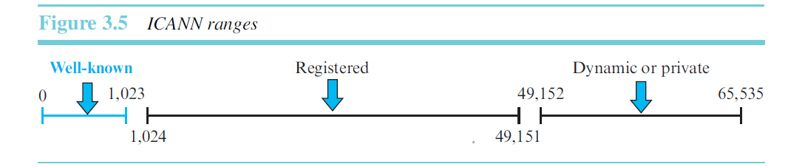
Addressing: Port Numbers
Although there are a few ways to achieve process-to-process communication, the most common is through the client-server paradigm
A process on the local host, called a client, needs services from a process usually on the remote host, called a server.

Slide 7
Well-known ports. The ports ranging from 0 to 1,023 are assigned and controlled by ICANN. These are the well-known ports.
Registered ports. The ports ranging from 1,024 to 49,151 are not assigned or controlled by ICANN. They can only be registered with ICANN to prevent duplication.
Dynamic ports. The ports ranging from 49,152 to 65,535 are neither controlled nor registered. They can be used as temporary or private port numbers.

Slide 8
A remote computer can run several server programs at the same time, just as several local computers can run one or more client programs at the same time.
For communication, the local host, local process, remote host, and remote process must be defined.
The local host and the remote host are defined using IP addresses
To define the processes, second identifiers, called port numbers are used.
In the TCP/IP protocol suite, the port numbers are integers between 0 and 65,535 (16 bits)

Slide 9
The client program defines itself with a port number, called the ephemeral port number. he word ephemeral means short-lived and is used because the life of a client is normally short.
An ephemeral port number is recommended to be greater than 1,023 for some client/server programs to work properly.
Server process cannot choose port number randomly.
TCP/IP has decided to use universal port numbers for servers; these are called well-known port numbers.

Slide 10
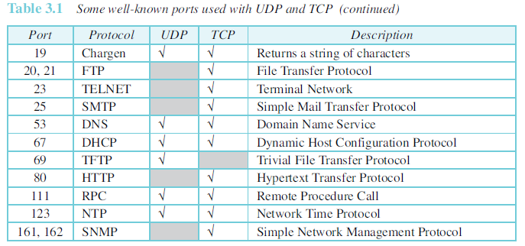
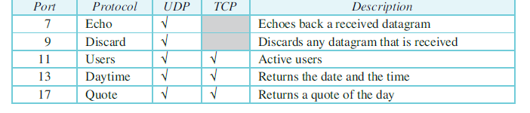

Slide 11
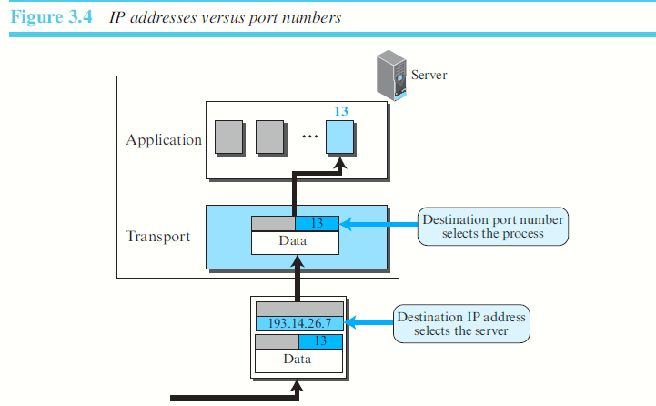

Slide 12
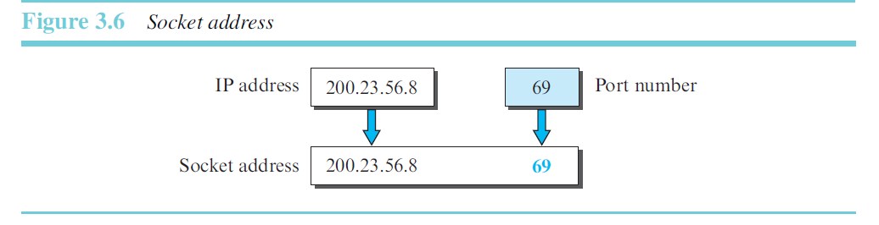

Slide 13
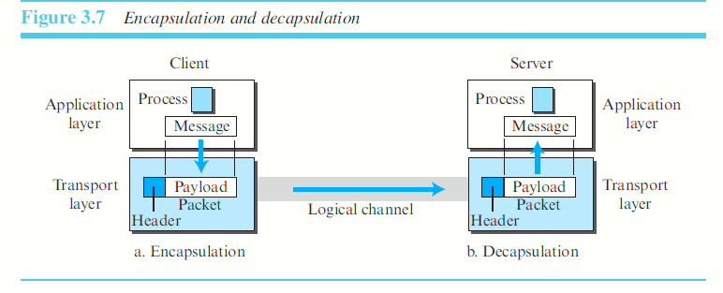

Slide 14
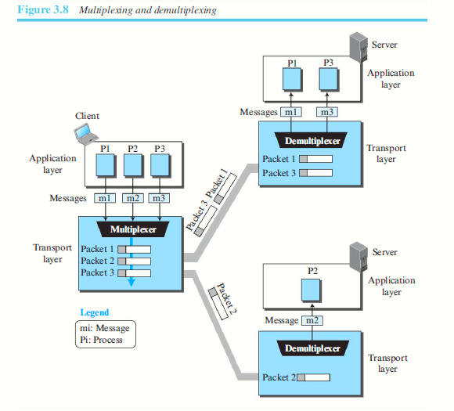

Slide 15
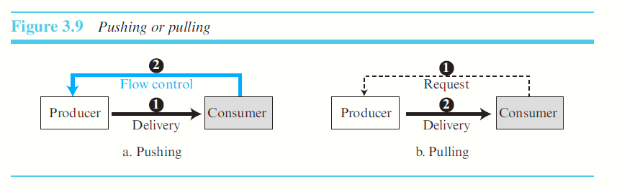

Slide 16
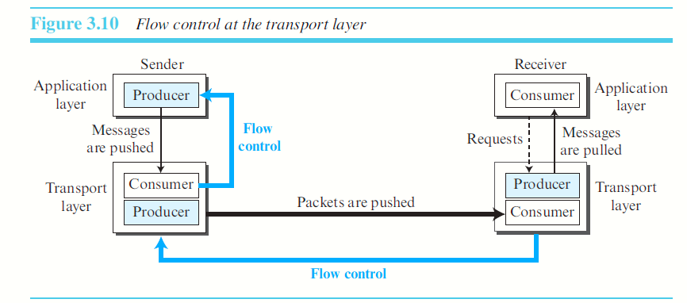

Slide 17
Buffers:
Flow control can be implemented in several ways.
One of the solutions is normally to use two buffers:
is a set of memory locations that can hold packets at the sender and receiver.
one at the sending transport layer and the other at the receiving transport layer.

Slide 18
When the buffer of the sending transport layer is full, it informs the application layer to stop passing chunks of messages;
when there are some vacancies, it informs the application layer that it can pass message chunks again.
When the buffer of the receiving transport layer is full, it informs the sending transport layer to stop sending packets.
When there are some vacancies, it informs the sending transport layer that it can send packets again

Slide 19
Error Control
The underlying network layer (IP) is unreliable.
To make the transport layer reliable, add error control services to the transport layer.
Error control at the transport layer is responsible for
Detecting and discarding corrupted packets.
Keeping track of lost and discarded packets and resending them.
Recognizing duplicate packets and discarding them.
Buffering out-of-order packets until the missing packets arrive.

Slide 20
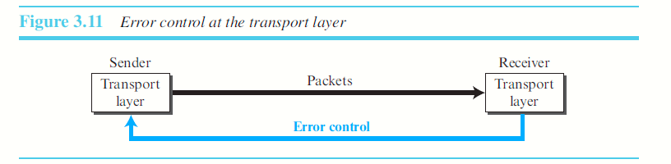
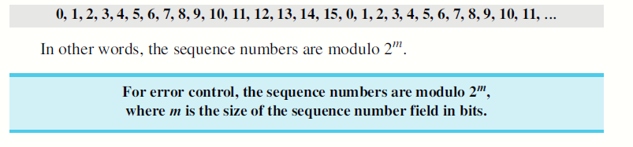
Sequence Numbers
Error control requires that the sending transport layer knows which packet is to be resent and the receiving transport layer knows which packet is a duplicate, or which packet has arrived out of order.
This can be done if the packets are numbered.
A field is added to the transport-layer packet to hold the sequence number of the packet.
Packets are numbered sequentially.

Slide 21
Acknowledgment
Both positive and negative signals as error control signals.
More common at the transport layer are positive signals.
The receiver side can send an acknowledgment (ACK) for each of a collection of packets that have arrived safe and sound.
The receiver can simply discard the corrupted packets.
The sender can detect lost packets if it uses a timer.
When a packet is sent, the sender starts a timer. If an ACK does not arrive before the timer expires, the sender resends the packet.
Duplicate packets can be silently discarded by the receiver.
Out-of-order packets can be either discarded (to be
treated as lost packets by the sender), or stored until the
missing ones arrives.

Slide 22
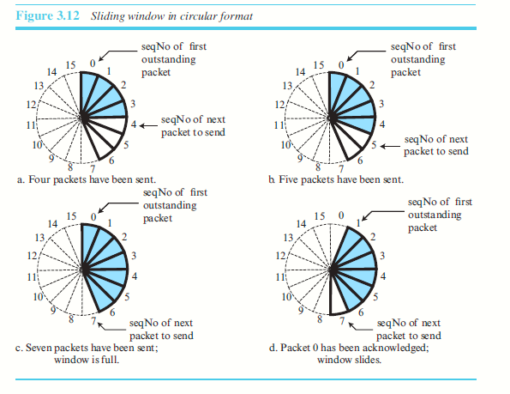
Sliding Window

Slide 23
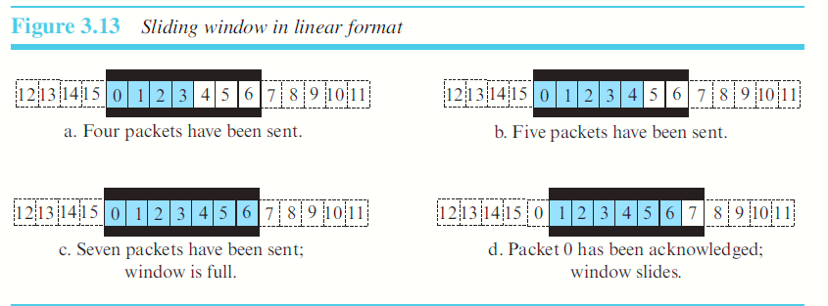

Slide 24
Congestion Control
Congestion in a network may occur if the load on the network increases—the more number of packets sent to the network—is greater than the capacity of the network—the number of packets a network can handle.
Congestion control refers to the mechanisms and techniques that control the congestion and keep the load below the capacity.
Congestion in a network or internetwork occurs because routers and switches have queues—buffers that hold the packets before and after processing

Slide 25
Connectionless and Connection-Oriented Services
At the network layer, a connectionless service may mean different paths for different datagrams belonging to the same message.
At the transport layer, it is the logical connection between two transport layers.
Connectionless service at the transport layer means independency between packets.
Connection-oriented means dependency.

Slide 26
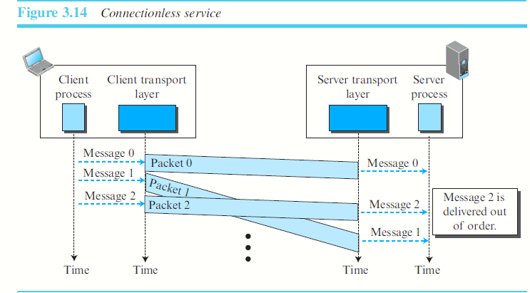
Connectionless - flow control, error control, or congestion control cannot be effectively implemented.

Slide 27
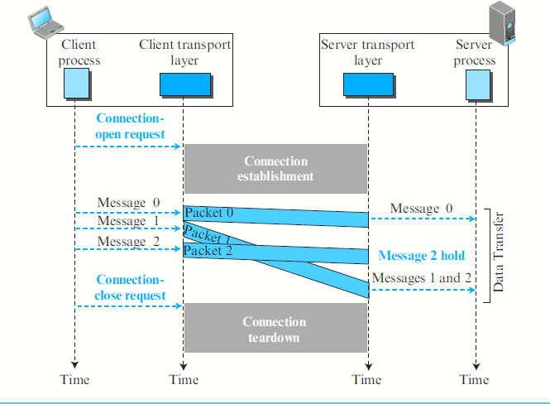
Connection-Oriented Services can implement flow control, error control, and congestion control

Slide 28
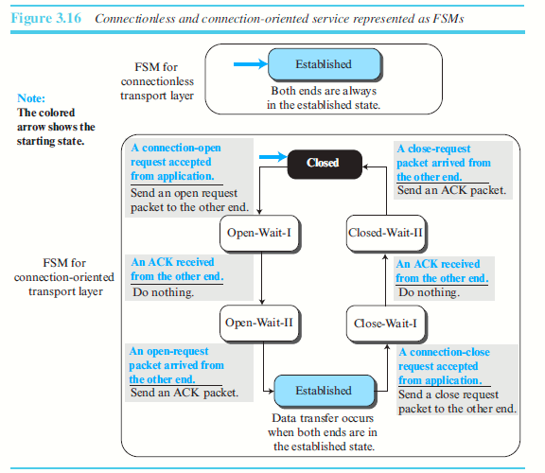
Finite State Machine

Slide 29
TRANSPORT LAYER PROTOCOLS
SIMPLE PROTOCOL
STOP AND WAIT PROTOCOL
GO BACK ‘N’ PROTOCOL
SELECTIVE REPEAT PROTOCOL

Slide 30
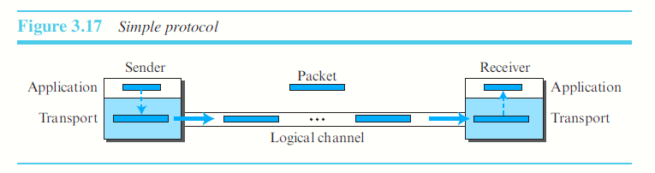
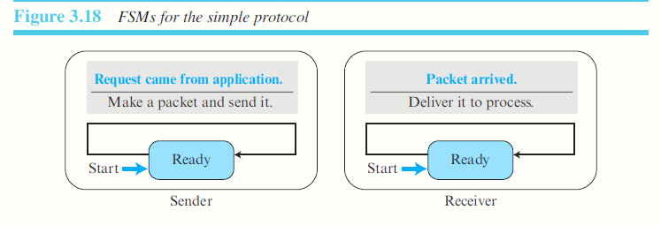
SIMPLE PROTOCOL- Connectionless

Slide 31
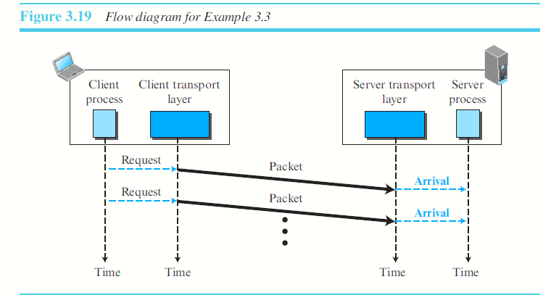
STOP AND WAIT PROTOCOL – SLIDING WINDOW SIZE IS ‘1’

Slide 32
STOP & WAIT
Connection-oriented protocol.
Uses both flow and error control.
Both the sender and the receiver use a Sliding window of size 1. The sender sends one packet at a time and waits for an acknowledgment before sending the next one.
Checksum is added with every packet to detect corrupted packets.
Receiver discards the packet if its corrupted.
A timer is set by sender after every packet is sent. If the acknowledgement is not received from the receiver then the packet is resent. (A copy of the packet has to be maintained by the sender for retransmissions).

Slide 33
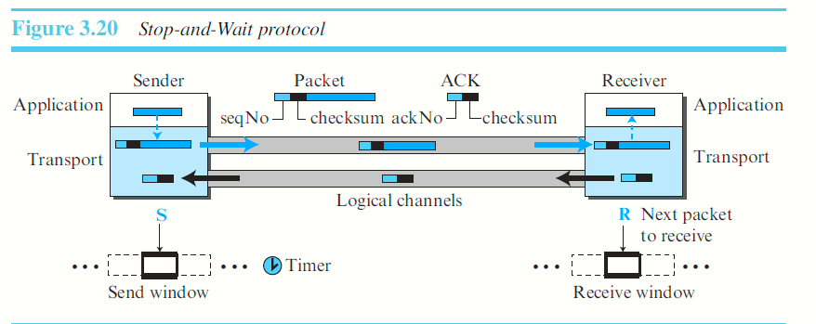

Slide 34
Sequence Numbers
Protocol uses sequence numbers and acknowledgment numbers to prevent duplicate packets.
Field is added to the packet header to hold the sequence number.
range of sequence numbers??
x & x+1 (modulo 2 arithmetic). Sequence number of a packet can always be either a 0 or 1

Slide 35
Three cases:
packet arrives safe and sound at the receiver site; the receiver sends an acknowledgment. The acknowledgment arrives at the sender site, causing the sender to send the next packet numbered x + 1.
packet is corrupted or never arrives at the receiver site; the sender resends the packet (numbered x) after the time-out. The receiver returns an acknowledgment.
packet arrives safe and sound at the receiver site; the receiver sends an acknowledgment, but the acknowledgment is corrupted or lost. The sender resends the packet (numbered x) after the time-out.

Slide 36
The packet in the third case is a duplicate.
The receiver can recognize this fact because it expects packet x + 1 but packet x was received.
There is no need for a packet to be numbered x + 2.
The sequence is 0, 1, 0, 1, 0, and so on.
Acknowledgment Numbers:
In the Stop-and-Wait protocol, the acknowledgment number always announces, the sequence number of the next packet expected (in
modulo-2 arithmetic).

Slide 37
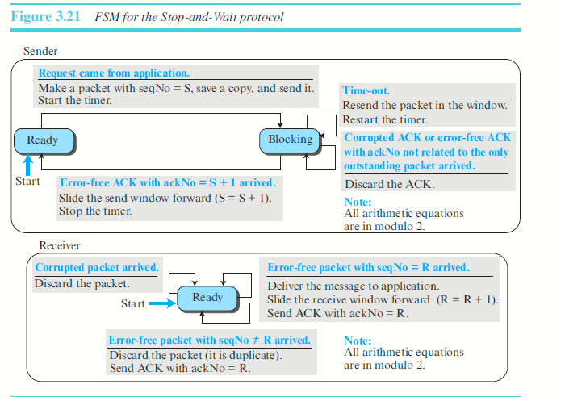
FSM – STOP N WAIT

Slide 38
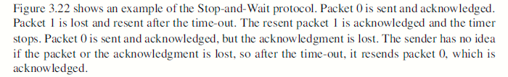
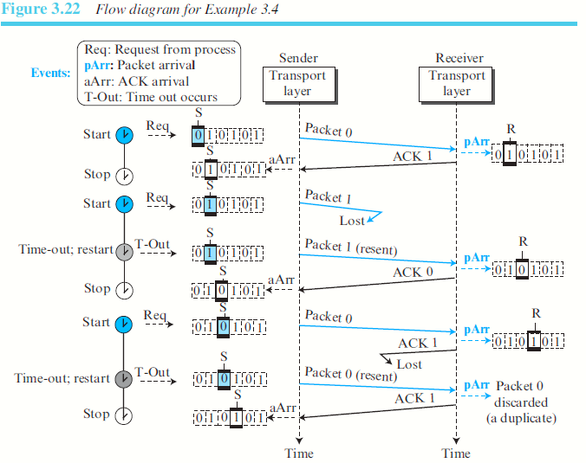

Slide 39
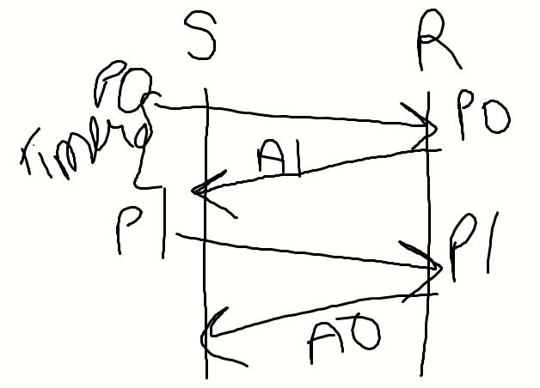
Successful transmission

Slide 40
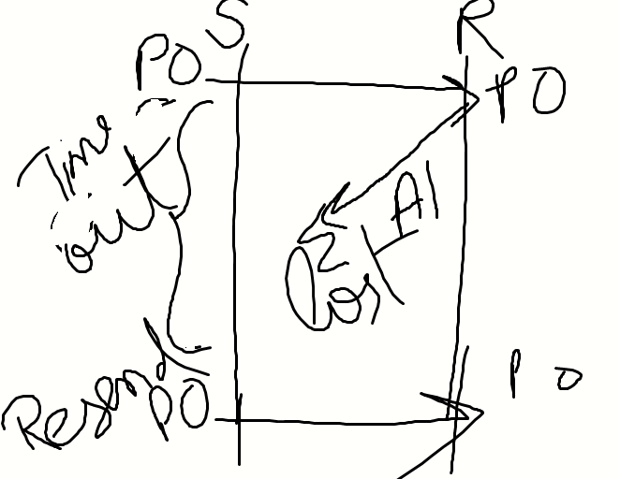
Acknowledgement lost Previous Packet resent

Slide 41
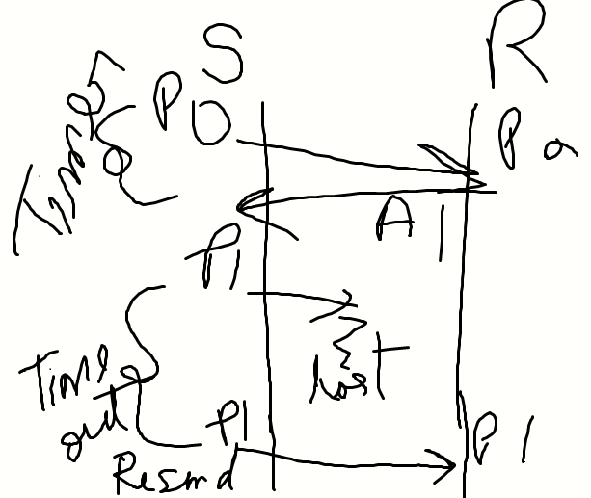
2nd Packet lost

Slide 42
Efficiency
The Stop-and-Wait protocol is very inefficient if our channel is thick and long.
Thick means that our channel has a large bandwidth (high data rate)
Long means the round-trip delay is long.
The product of these two is called the bandwidth-delay
product.
The bandwidth-delay product then is the volume of the pipe in bits.
The bandwidth-delay product is a measure of the number of bits a sender can transmit through the system while waiting for an acknowledgment from the receiver.

Slide 43
Assume that, in a Stop-and-Wait system, the bandwidth of the line is 1 Mbps, and 1 bit takes 20 milliseconds to make a round trip. What is the bandwidth-delay product?
If the system data packets are 1,000 bits in length, what is the utilization percentage of the link?
The bandwidth-delay product is (1 × 10⁶) × (20 × 10⁻³) = 20,000 bits.
The system can send 20,000 bits during the time it takes for the data to go from the sender to the receiver and the acknowledgment to come back.
Link utilization is only 1,000/20,000, or 5 percent
What is the utilization percentage of the link in above Example, if we have a protocol that can send up to 15 packets before stopping and worrying about the acknowledgments?
The bandwidth-delay product is still 20,000 bits. The system can send up to 15 packets or 15,000 bits during a round trip. This means the utilization is 15,000/20,000, or 75 percent

Slide 44
Pipelining
In networking and in other areas, a task is often begun before the previous task has ended.
There is no pipelining in the Stop-and-Wait protocol because a sender must wait for a
packet to reach the destination and be
acknowledged before the next packet can be
sent.

Slide 45
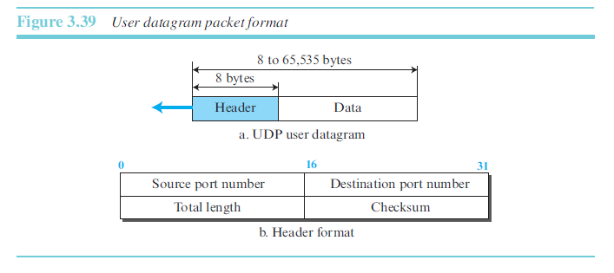
USER DATAGRAM PROTOCOL (UDP)
The User Datagram Protocol (UDP) is a connectionless, unreliable transport protocol. It does not add anything to the services of IP except for providing process-to-process communication instead of host-to-host communication.

Slide 46
Example 3.11
The following is the contents of a UDP header in hexadecimal format. CB84000D001C001C
a. What is the source port number?
b. What is the destination port number?
c. What is the total length of the user datagram?
d. What is the length of the data?
e. Is the packet directed from a client to a server or vice versa?
f. What is the client process?

Slide 47
Solution
a. The source port number is the first four hexadecimal digits (CB84)16 , which means that
the source port number is 52100.
b. The destination port number is the second four hexadecimal digits (000D)16, which
means that the destination port number is 13.
c. The third four hexadecimal digits (001C)16 define the length of the whole UDP packet as
28 bytes.
d. The length of the data is the length of the whole packet minus the length of the header, or 28 − 8 = 20 bytes.
e. Since the destination port number is 13 (well-known port), the packet is from the client
to the server.
f. The client process is the Daytime.

Slide 48
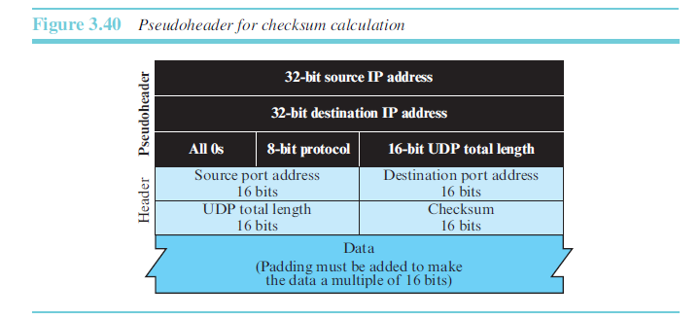

Slide 49
Process-to-Process Communication
UDP provides process-to-process communication using socket addresses, a combination of IP addresses and port numbers.

Slide 50
Typical Applications
The following shows some typical applications that can benefit more from the services of UDP than from those of TCP.
UDP is suitable for a process that requires simple request-response communication with little concern for flow and error control. It is not usually used for a process such as FTP that needs to send bulk data.
UDP is suitable for a process with internal flow- and error-control mechanisms. For example, the Trivial File Transfer Protocol (TFTP) process includes flow and error control. It can easily use UDP.
UDP is a suitable transport protocol for multicasting. Multicasting capability is embedded in the UDP software but not in the TCP software.
UDP is used for management processes such as SNMP.
UDP is used for some route updating protocols such as Routing Information Protocol (RIP).
UDP is normally used for interactive real-time applications that cannot tolerate uneven delay between sections of a received message

